Slide 1
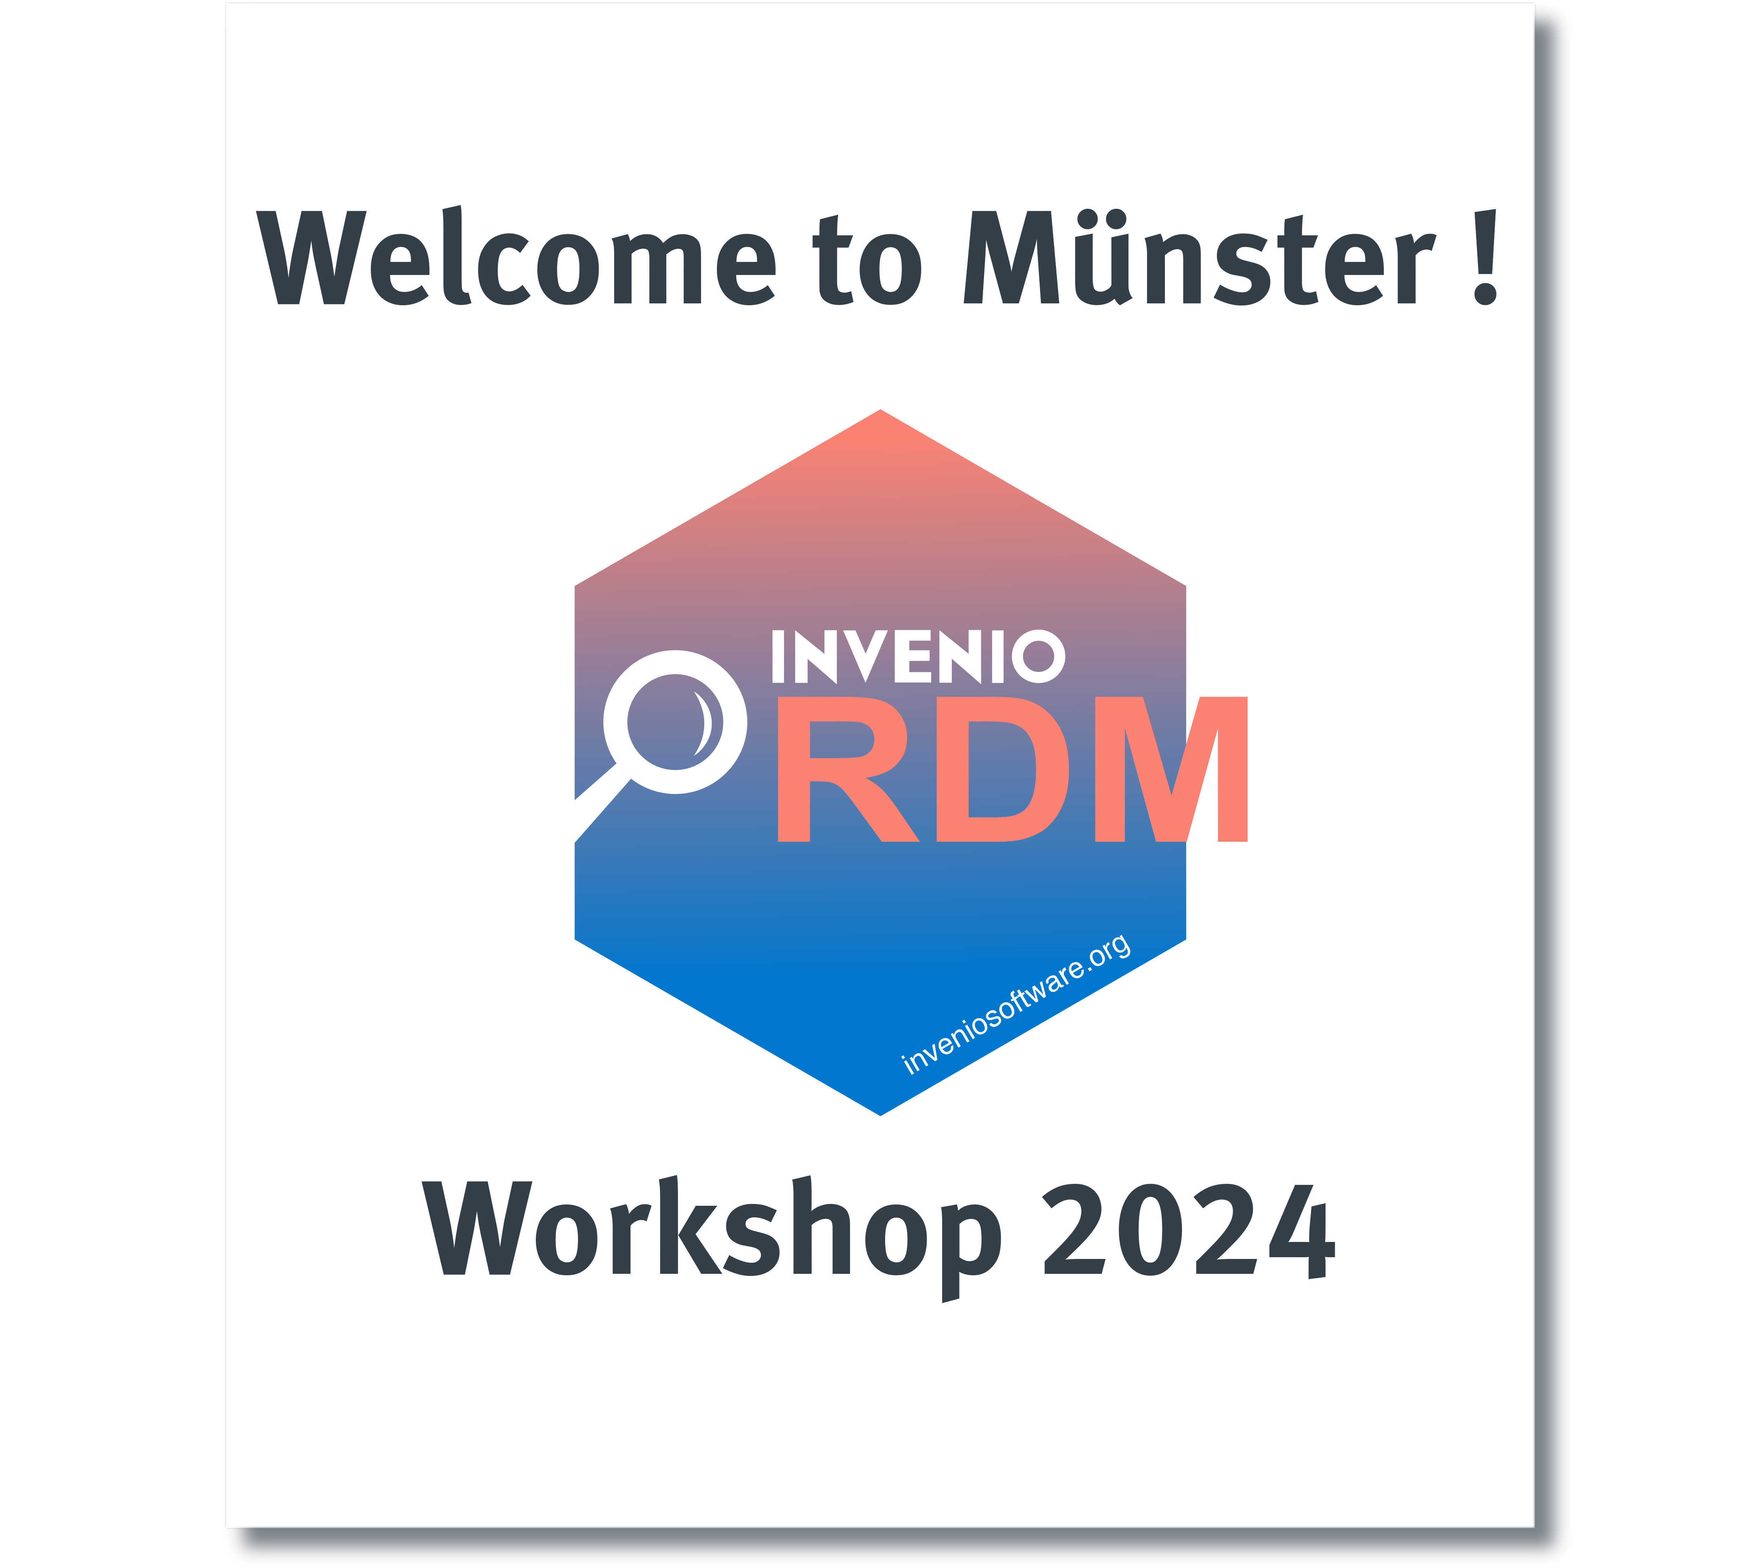
InvenioRDM Workshop
Münster 2024
Markus Klöpper

Slide 2
Agenda
Overview
Open Space Technology
Learnings
Voices of the community

Slide 3
Overview
44 participants
From ten different countries
26 Sessions over 3 days
A lot of work and talks
2 merge parties
Notes:
Austria
Czech Republic
France
Germany
Ghana
Italy
Japan
Switzerland
United Kingdom
United States of America

Slide 4
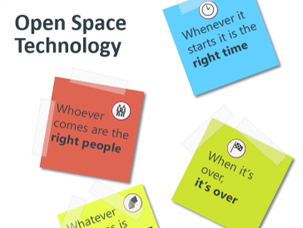
Open Space Technology
4 Priciples
Whoever comes are the right people
Whenever it starts it is the right time
When it‘s over it‘s over
Whatever happens is the only thing that could happen

Slide 5
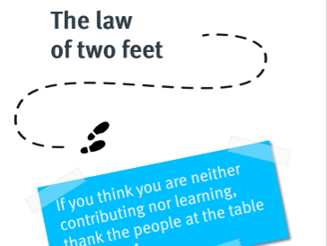
Open Space Technology
The law of two feet
If you think you are neither contributing nor learning, thank the people at the table and move!

Slide 6
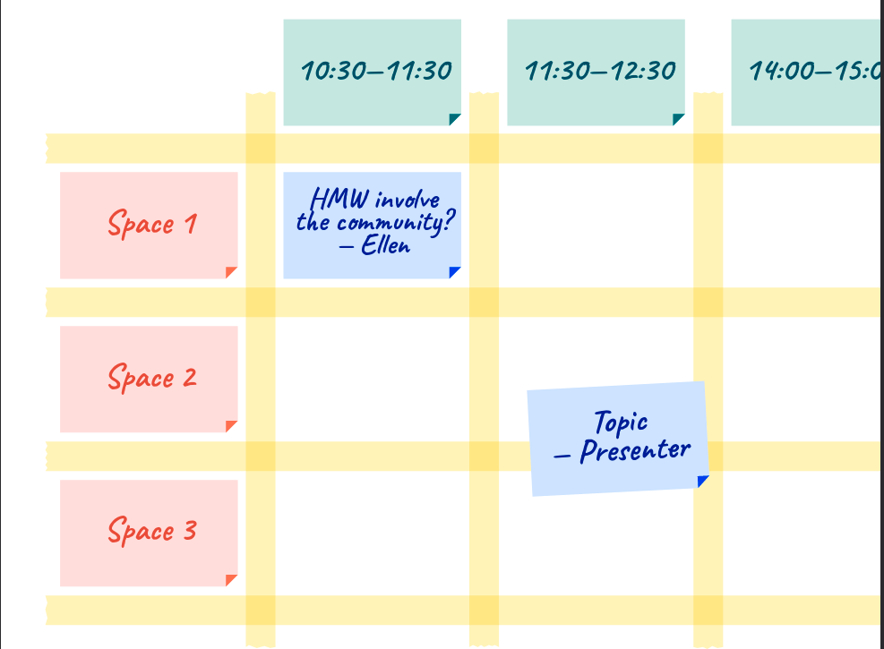
Open Space Technology
Time / Space grid
Community tailored
Dynamic adjustments
Allows for spontaneous Ideas / sessions

Slide 7
Learnings
OST → Make it even more open!
We have great community
Meeting face to face was long overdue
Having already setup documentation tools is crucial

Slide 8
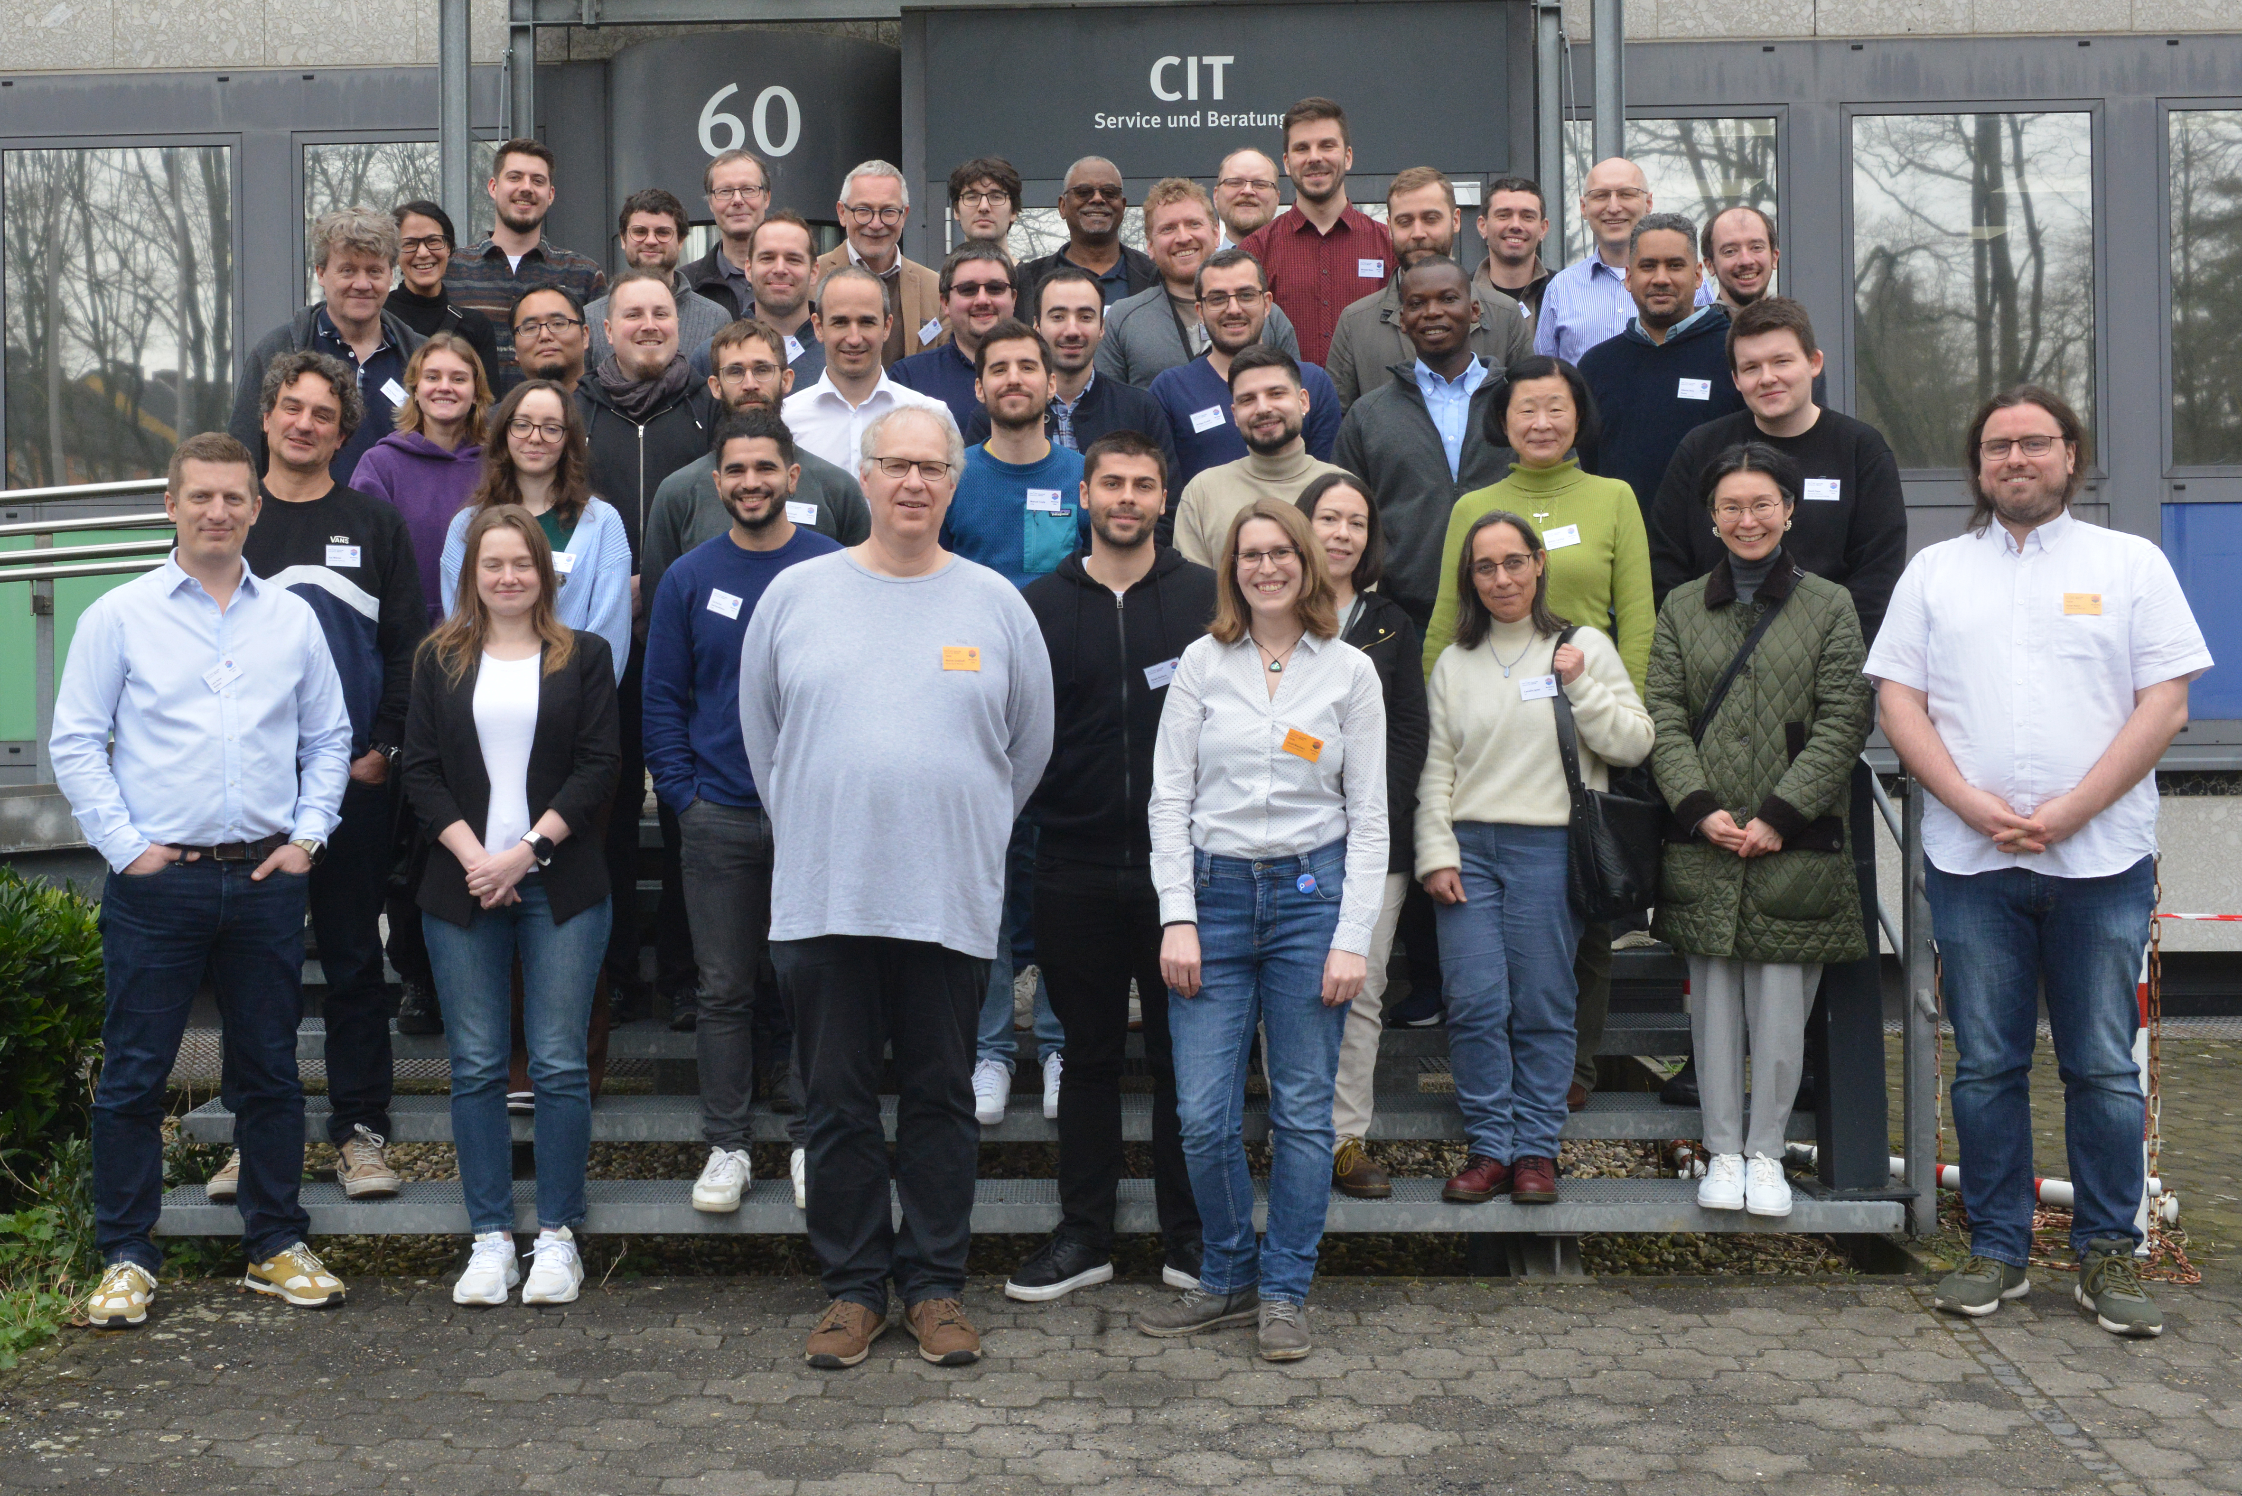
Voices of the community

Slide 9
The end
Who will organize the next workshop?

